Slide 1

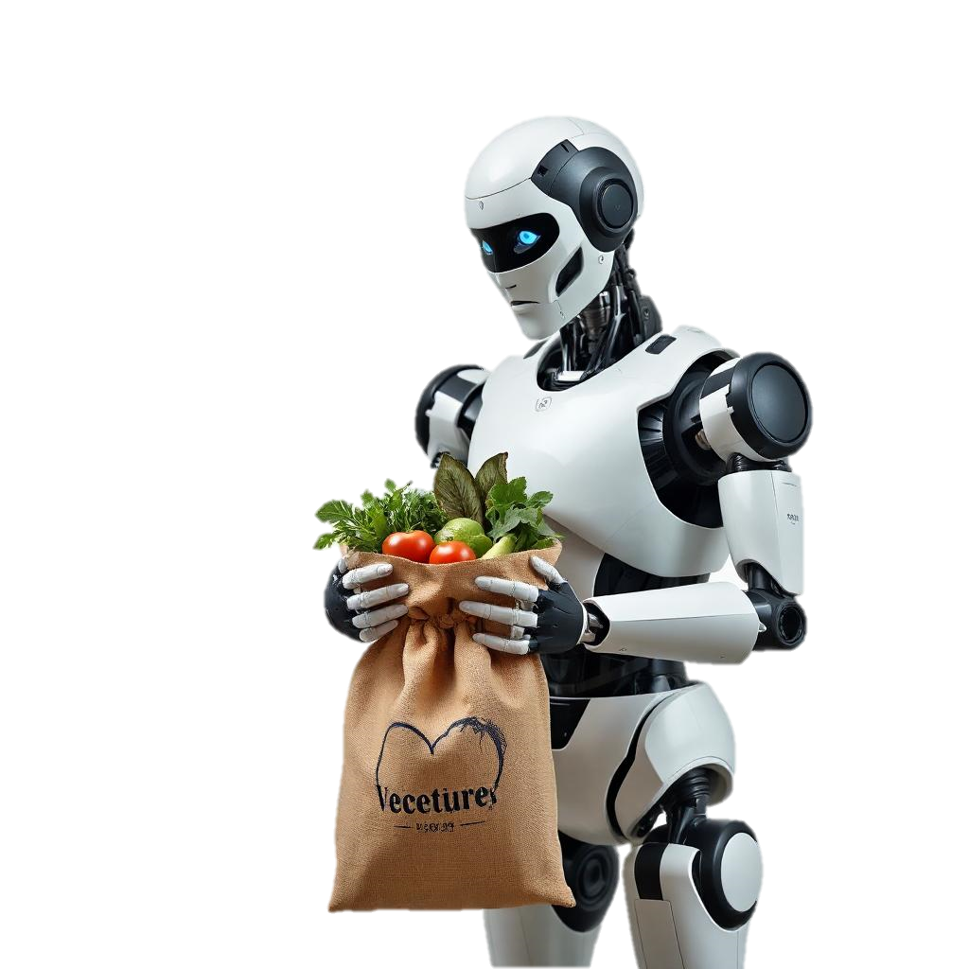
ECONOMIC FOOD EXCHANGER
Presented by: W A Nimni Reshani
RegNo : 520274515
Supervisor : Mrs .Wasana Uduwela

Slide 2

CONTENT
INTRODUCTION
PROBLEM
AIM
OBJECTIVES
METHODOLOGIES
PROPOSED APPROACH
LITERATURE REVIEW
USECASE
ER-DIAGRAM
CLASS DIAGRAM
TIME SCHEDULE
ECONOMIC FOOD EXCHANGER

Slide 3

INTRODUCTION
Agriculture is a vital industry worldwide, essential for food safety and economic stability.
Farmers harvest their crops.
Harvest collectors load the produce onto their trucks.
Collectors transport the produce to economic centers.
Shop owners and wholesalers purchase the produce from these centers.
Wholesalers then transport the produce to different cities.
Retailers buy the produce from wholesalers and sell it to consumers.
Here’s a typical flow of fruits and vegetables from farm to consumer:

Slide 4

PROBLEM
High retail prices and low farmer profits due to multiple intermediaries
Complex distribution process leading to high costs and lower profits for the farmer.
Lack of transparency and quality control in the current supply chain

Slide 5


AIM
The aim of this project is to develop a web based application to build agricultural product based community and to streamline the supply chain for vegetables and fruits in Sri Lanka by reducing intermediaries, ensuring fair pricing for consumers, empowering farmers with better profits, and providing quality products to customers.

Slide 6



OBJECTIVES
Analyze the Food Supply Chain & Analyze the existing systems
Identify Requirements
Design the Web System
Develop a User-Friendly and Secure System

Slide 7


METHODOLOGIES
Research & Analyzing
Interview with a farmer
Interview with a Seller
Interview with wholesale seller
Interview with retail seller
Observe the market places
Visiting the economic food exchanger
Online market places (Facebook , Ikman.lk)
Design and Prototyping
Design UML diagrams
Adobe Illustrator
Scratching the UI/Figma
Doing usability testing by using the prototype
Development
Front End
React
Backend
Spring Boots java frame work
Data Base
MySQL
Maintenance and Updates
Bug fixing
Optimizing the performance and issues
Given update and new features update as user preference
Testing
Doing Manual Testing
Unit Testing (testing Model vise)
Integration Testing (integration between model)
System Testing (Testing the whole testing)

Slide 8
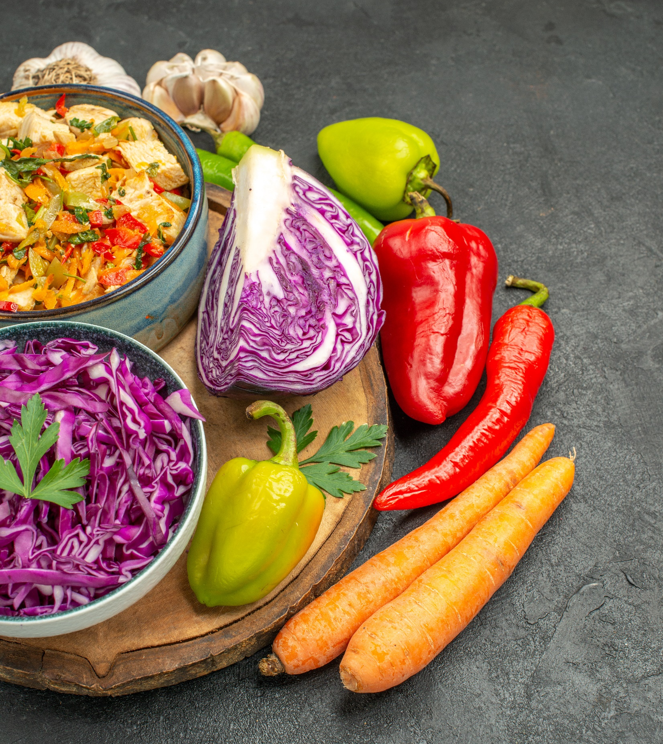
Proposed Approach
This platform will facilitate direct contact between buyers and sellers across the country
It will have,
Privilege Management
Product Management
Analytics and Reporting
Marketing and Promotions
Feedback and Review

Slide 9

LITERATURE REVIEW

Slide 10





The Facts of the Selection:-
popularity in their respective markets
The literature review for the Economic Food Exchanger project provides a detailed comparison with several prominent platforms in the agricultural and retail sectors
Alibaba Agriculture
Leading website that in online store in the
Cargills Food City
One of Sri Lanka’s largest retail chains
Keells
A prominent supermarket chain in Sri Lanka.
Spar2u.lk
The online shopping platform for SPAR supermarkets in Sri Lanka.
FreshDirect
An online service offering a farm-to-door experience
Kapruka
A well-known e-commerce site in Sri Lanka
Arpico Supercentre
A chain of hypermarkets and supermarkets in Sri Lank
Govimithuru
A digital platform connecting Sri Lankan farmers with consumers
Lassana.com
An online retailer in Sri Lanka. That have different item form different seller
Farmers Market Online.
An online marketplace providing direct access to farm-fresh products

Slide 11

FEATURE OF THE WEBSITE
 | Alibaba Agriculture | Cargills Food City | Keells | spar2u.lk | FreshDirect | Kapruka | Arpico Supercentre | Govimithuru | Lassana.com | Farmers Market Online | Economic Food Exchanger
a) | ✔ | ✔ | ✔ | ✔ | ✔ | ✔ | ✔ | ✔ | ✔ | X | ✔
b) | ✔ | ✔ | ✔ | ✔ | ✔ | ✔ | ✔ | ✔ | ✔ | X | ✔
c) | ✔ | ✔ | ✔ | ✔ | ✔ | ✔ | ✔ | X | ✔ | X | ✔
d) | X | X | X | X | X | X | X | X | X | X | ✔
e) | X | X | X | X | X | X | X | X | X | ✔ | ✔
f) | ✔ | ✔ | ✔ | ✔ | ✔ | ✔ | ✔ | X | ✔ | ✔ | ✔
g) | X | X | X | X | X | X | X | X | X | X | ✔
h) | ✔ | X | X | X | X | X | X | X | X | ✔ | ✔
i) | X | X | X | X | X | X | X | ✔ | X | X | ✔
j) | X | X | X | X | X | X | X | X | X | X | ✔
k) | X | X | X | X | X | X | X | ✔ | X | X | ✔
l) | ✔ | ✔ | ✔ | ✔ | ✔ | ✔ | ✔ | X | ✔ | X | ✔
m) | ✔ | X | X | X | X | X | X | X | X | X | ✔
n) i) | ✔ | ✔ | ✔ | ✔ | ✔ | ✔ | ✔ | X | ✔ | X | ✔
n) ii) | X | X | X | X | X | X | X | X | X | X | ✔
n) iii) | X | X | X | X | X | X | X | X | X | X | ✔
a) Display wall
b) Register & Login
c) Add Review
d) List Request Agricultural product and Item
e) List Seller Agricultural Products and Items
f) Selling Request Handling
g) Buying Request Handling
h) Publicly Listing Availability
i) Define Retail Price
j) Listing Peripheral Items
k) Adding Instructions & Guidelines
l) Payment state and method Handling
m) Delivery State Update
n) Report Generating
i. Selling Item report
ii. Item Price report
iii. Displaying Item Location on the map

Slide 12

Diagrams for proposed system
Use case Diagram
Er Diagram
Class Diagram

Slide 13
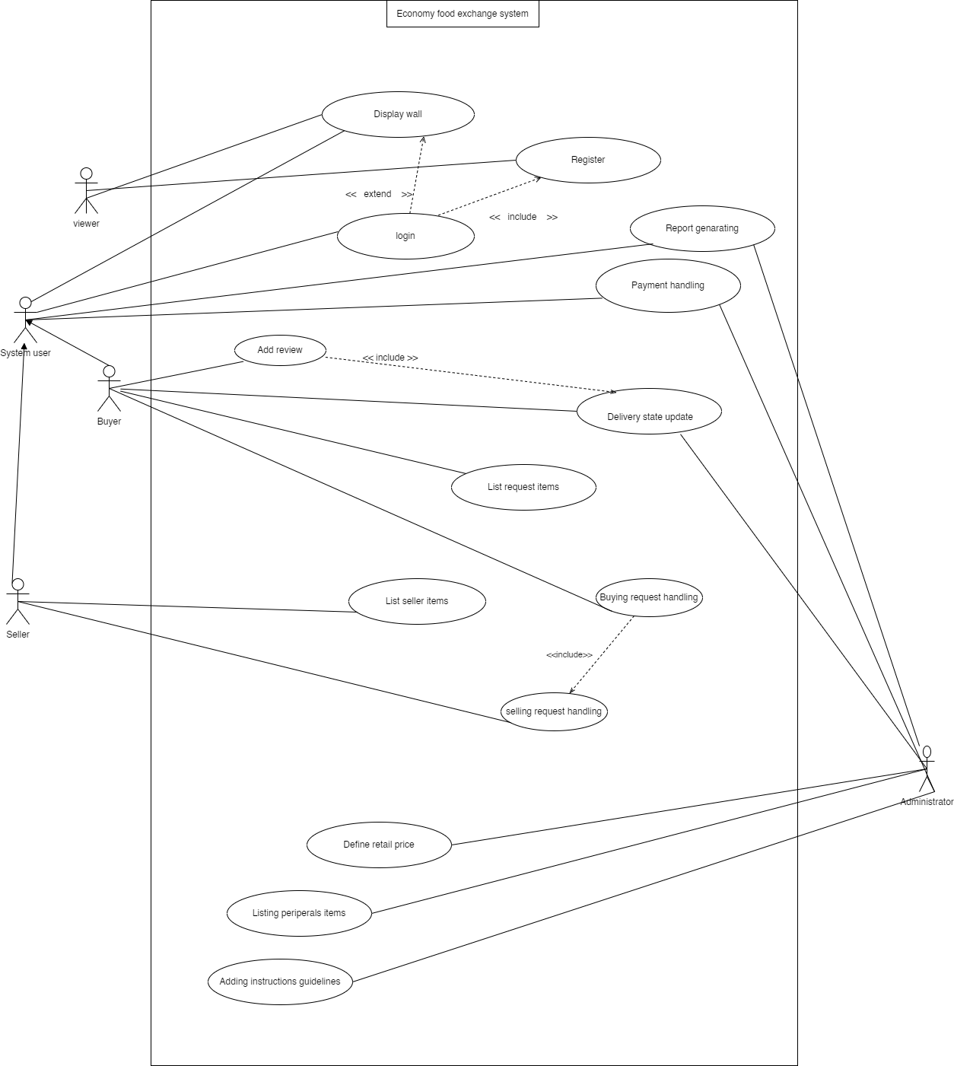
Usecase For Proposed System

Slide 14
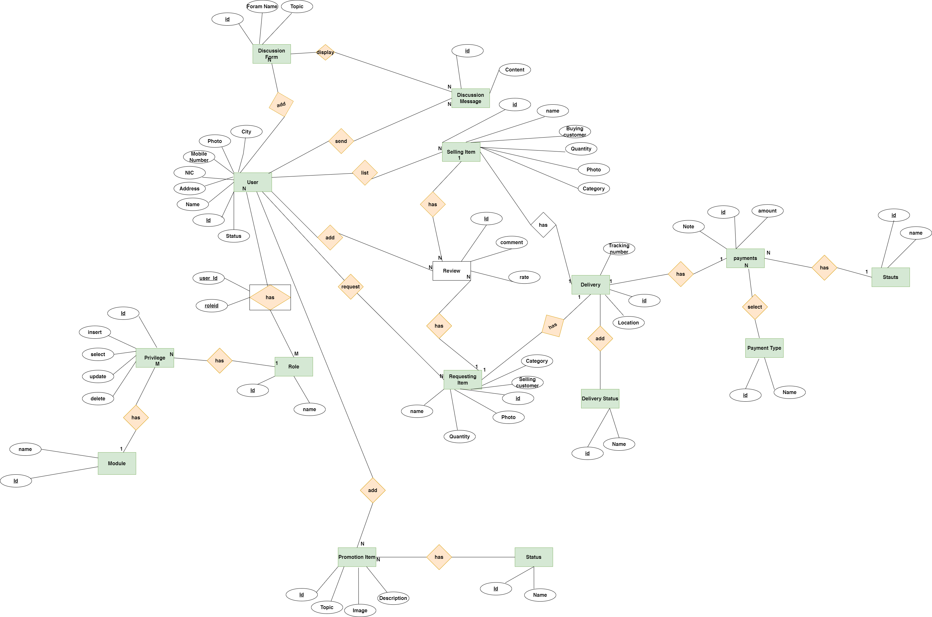
ER- DIAGRAM

Slide 15
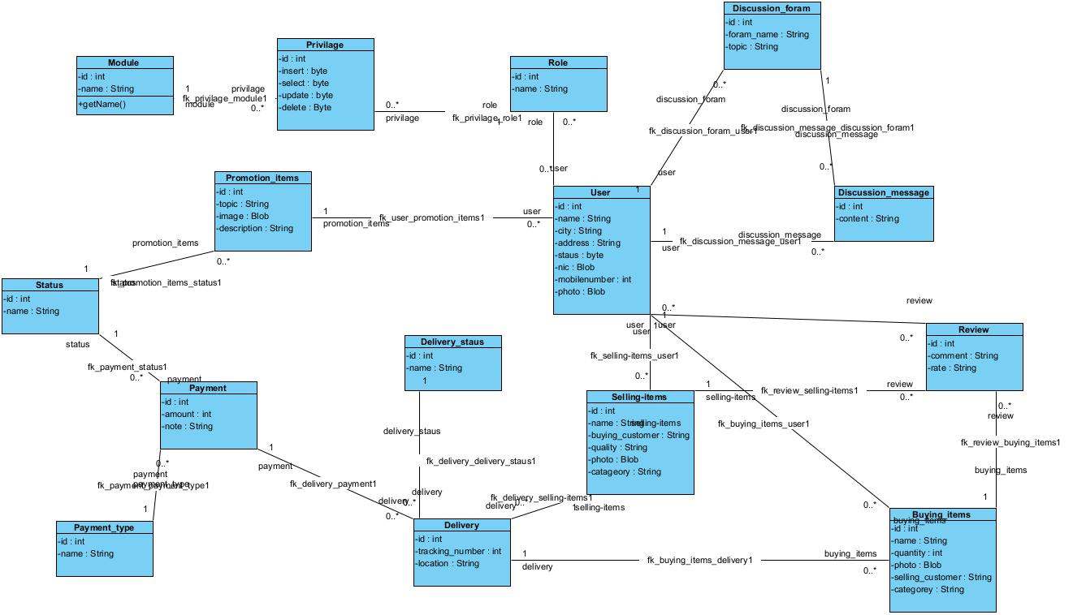
Class- DIAGRAM

Slide 16
Developed Features
Feather Development
Display wall
Register & Login
List Request Agricultural product and Item
List Seller Agricultural Products and Items
Selling Request Handling
Buying Request Handling
Define Retail Price
Payment state and method Handling
Delivery State Update
Item Price report
Selling Item report
Listing Peripheral Items
Adding Instructions & Guidelines
Server side handling of the User settings
User Authentications and Authorizations

Slide 17


